Slide 1
2024

Slide 2
Coolshop in 2023 Impressive growth and huge investments in 2023
Top line growth of +10% in 2023 (E-commerce businesses in DK at index 95 in 2023).
2 million online visitors each month, 40% men / 60% women, 300.000 active subscribers of our newsletter.
Huge investments in marketing and present among others on Google, Youtube, META and relevant price sites.
A rating of 4,6 at Trustpilot based on more than 160.000 reviews.
Extra 10.000 m2 of storage facilities – warehouse of total 30.000 m2.
Automated picking of goods via the newest robotic technology.

Slide 3
The New Coolshop Ambitious growth strategy for 2024
Present in 8 countries, Polen opens in 2024 and 2 countries annually thereafter.
Ambitious growth strategy with a minimum annual growth of 15%.
Opening our first brick and mortar store of 1.500 m2 in August 2024 showing Coolshop from a new side.
Same Day delivery in Denmark.
Massive investments in a our logistic set-up including a new fully automatic packaging machine.
New HQ-office facilities of 3,500 m2 opens in Spring 2024.
Intensive work and interest in ESG and sustainability.
Notes:
ESG står for Environmental, Social and Governance = bæredygtighed

Slide 4
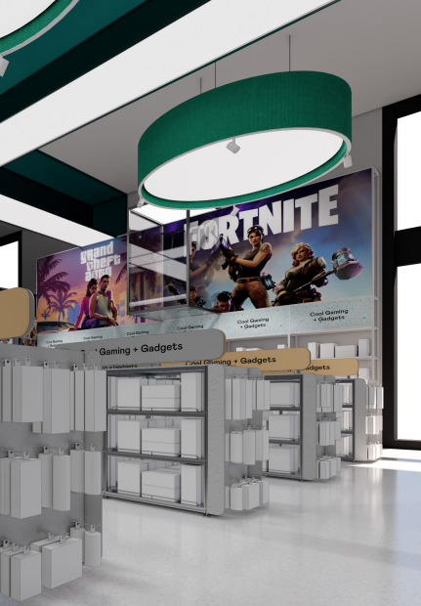
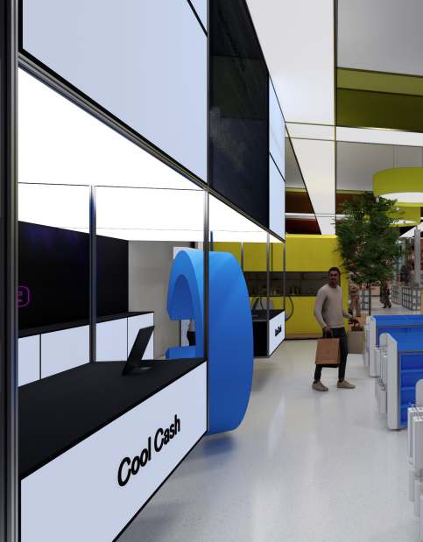
The New Coolshop New store of 1.500 m2 - Games
Notes:
ESG står for Environmental, Social and Governance = bæredygtighed

Slide 5
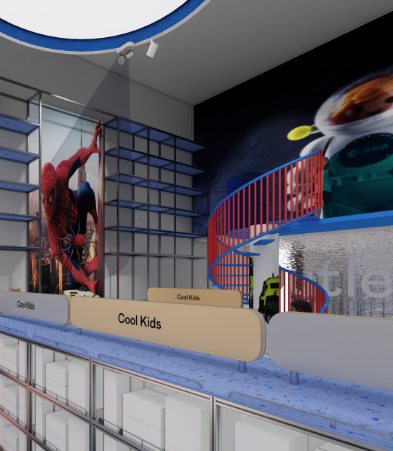
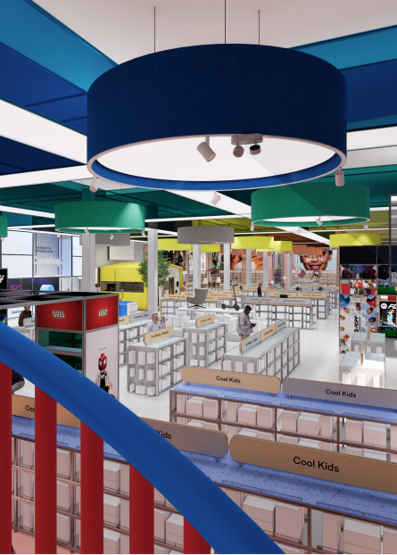
The New Coolshop New store of 1.500 m2 - Toys
Notes:
ESG står for Environmental, Social and Governance = bæredygtighed

Slide 6
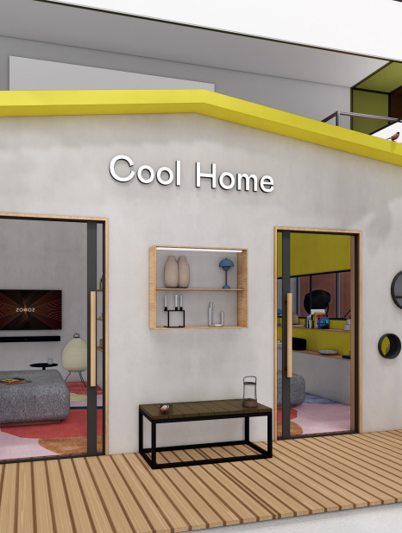
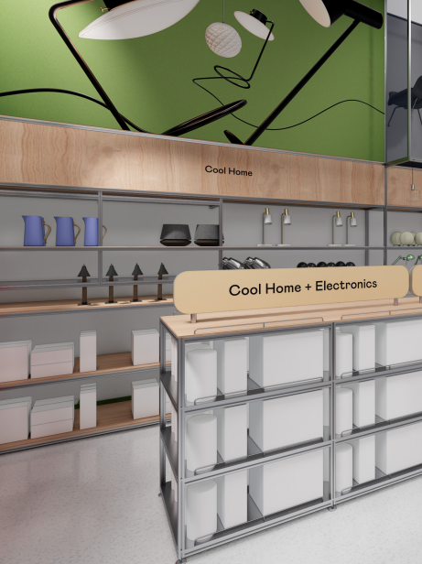
The New Coolshop New store of 1.500 m2 – Electronics / Home
Notes:
ESG står for Environmental, Social and Governance = bæredygtighed

Slide 7
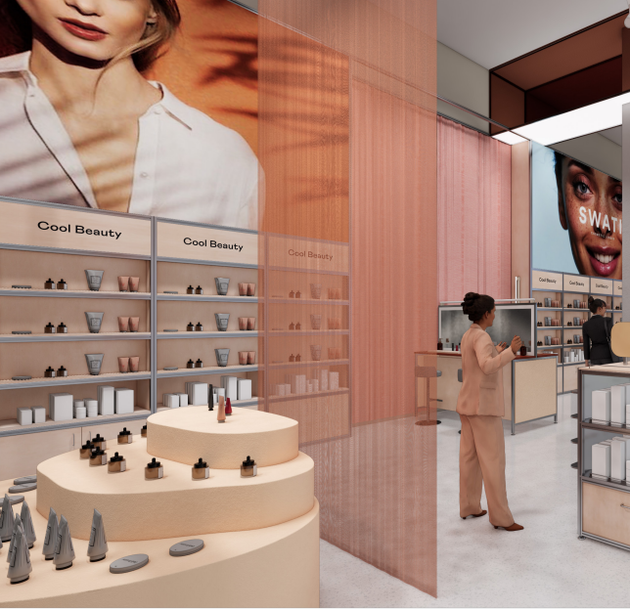
The New Coolshop New store of 1.500 m2 - Beauty
Notes:
ESG står for Environmental, Social and Governance = bæredygtighed

Slide 8
Annual Meeting 2024
Bayer - Agenda
2023, What went well and what can we improve together
SS24, News
Item list, are we up to date on all SKUs, old and new
Slowmovers
Overstock
Offers (for delivery now and Black Friday)
AW24 (news/PO.)
Marketing 2024 (Marketing Menu Card)
Beauty kids
News letter
Terms 2024
Notes:
ESG står for Environmental, Social and Governance = bæredygtighed

Slide 9
Annual meeting 2024 - Terms
Purchase of goods 2022: 672.705
Purchase of goods 2023: 864.200
2023
2024
Payment: 60 days
VR Discount: 2%
Bonus:
Marketing:
Impairments:
Slowmovers:
Payment:
VR Discount:
Bonus:
Marketing:
Impairments:
Slowmovers:

